Slide 1
Reducing Energy Consumption & Maximizing Battery Life
Thursday, August 29, 8:00 AM - 8:55 AM
Matt Liberty
Principal Engineer
Jetperch LLC
matt@jetperch.com
Notes:
Title:
Reducing Energy Consumption and Maximizing Battery Life
Info:
Track: ESC - IoT & Connected Devices
Thursday, Aug 29, 8:00 AM - 8:55 AM
Room 209
August 27-29, 2019
Santa Clara Convention Center
Santa Clara, CA
Speaker:
Matt Liberty, Principal Engineer, Jetperch LLC
matt@jetperch.com
Abstract:
More and more devices require careful attention to energy consumption. Devices as diverse as mobile phones, toys, and Internet of Things end nodes all run on batteries. However, no one wants to change or recharge batteries. Even always-on mains powered devices are concerned with power consumption to meet energy regulations, reduce cost, and consume less energy.
This talk explores the techniques and methods to develop products that wisely consume only the energy that they need. Following a quick review of current, voltage, power, and energy, this session will cover:
The techniques used to budget for energy consumption during the initial product design
The equipment and methods used to measure voltage, current, power & energy
The common ways of reducing energy consumption in your product after you have hardware and software. These techniques span both hardware and software.
Attendee takeaways:
Attendees will gain a broader perspective on the tips, tricks and techniques to develop products with lower energy consumption which they can immediately apply to their own product designs.
Intended audience:
Hardware engineers, software engineers, developers and managers interested in creating products that consume less energy.

Slide 2
Agenda
Electrical quantities
Design
Measurement
Optimization
Conclusion

Slide 3
Agenda
Electrical quantities
Design
Measurement
Optimization
Conclusion

Slide 4
Electrical Quantities
Quantity |  | Unit |  | Description
Voltage | V | volt | V | How much electrons want to flow
Current | I | ampere | A | How many electrons are flowing
Charge | C | coulomb | C | How many electrons are gathered
Resistance | R | ohm | Ω | How much the circuit inhibits electron flow
Power | P | watt | W | The rate at which work is performed
Energy | E | joule | J | The amount of work performed

Slide 5
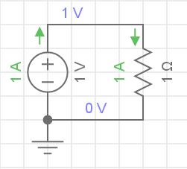
Ohm’s Law
V = I * R
I = V / R
R = V / I
Voltage = Current * Resistance
V
V
I
R

Slide 6
Power
P = V * I = V² / R = I² * R
Power = Voltage * Current

Slide 7
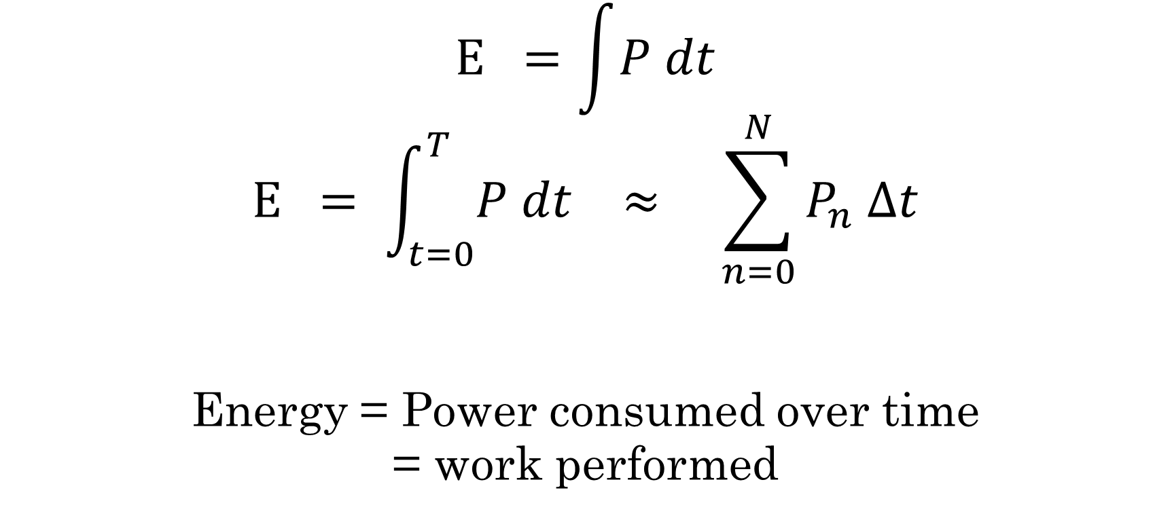
Energy
$$E =\int{P dt}$$
$$E = \int_{t=0}^{T}{P dt} ≈ \sum_{n=0}^{N}{P_{n} Δt}$$
Energy = Power consumed over time
= work performed

Slide 8
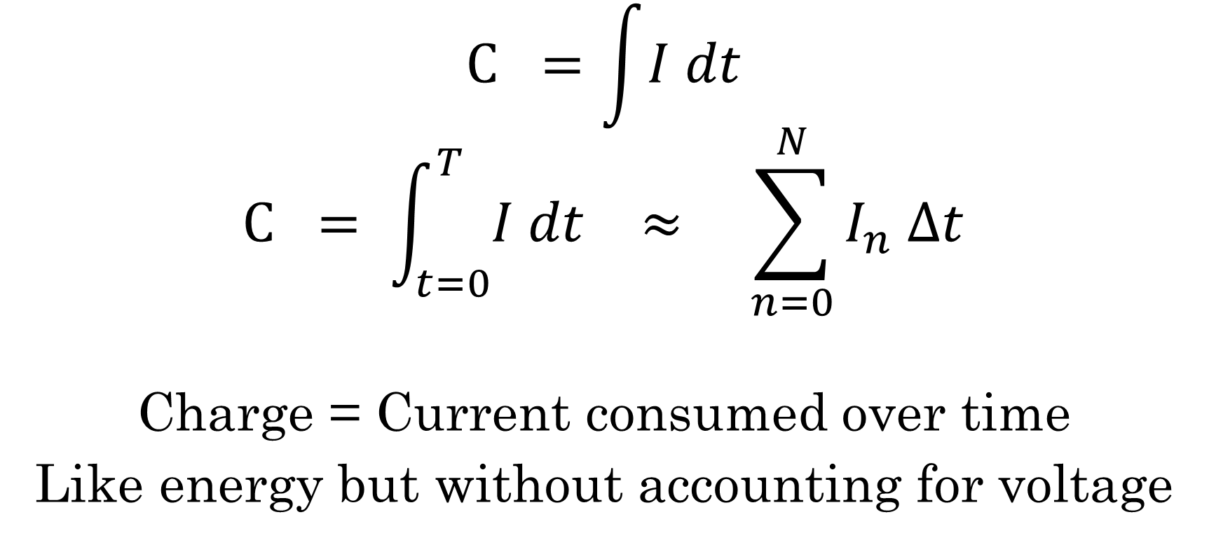
Charge
$$C =\int{I dt}$$
$$C = \int_{t=0}^{T}{I dt} ≈ \sum_{n=0}^{N}{I_{n} Δt}$$
Charge = Current consumed over time
Like energy but without accounting for voltage

Slide 9
Agenda
Electrical quantities
Design
Measurement
Optimization
Conclusion

Slide 10
Initial Design
Electrical components consume power
Power design impacts many decisions
  Component selection
  Schematic design
  Software architecture
Must design for power consumption early
  Low power consumption does not just happen
  Adding in low-power and long battery life late in a project causes delays

Slide 11
Initial Design for Low-Power
Select
energy-efficient components
Arrange
components to consume less energy
Consider active AND sleep modes
Balance features against available components
Consider reset, pull-up and pull-down resistors
Consider power domains, power gating, back-powering
Configure
to consume less energy
Consider sleep-mode signal state
Disable unused devices & peripherals
Enter lowest possible power state & GPIO state
Many products have multiple power modes and spend a lot of time “sleeping”

Slide 12


Should we design for energy or charge?

Slide 13
Switching Regulators: Optimize for Energy
Switching regulators convert between voltage and current
  Step voltage up or down
  Deliver required current (within limits)
Advantages
  Can accommodate a wide range of supply voltages efficiently
Disadvantages
  Higher quiescent current (compared to linear regulators) may increase sleep mode energy consumption
  Has additional efficiency losses that also vary based upon load current, input voltage and output voltage
  Increased noise and EMI/EMC concerns

Slide 14
Linear Regulators: Optimize for Charge
Linear regulators, including LDO regulators, regulate voltage
  Conceptually equivalent to a variable resistor that changes resistance to give fixed output voltage
  Charge is (mostly) conserved between input and output
Advantages
  Simpler to design with lower noise
  Low quiescent current for great sleep-mode performance
Disadvantages
  Requires a minimum drop-out voltage which limits efficiency
  Dissipates extra energy due to “voltage-drop” as heat proportional to current

Slide 15
Energy / Charge Budget
Estimate how much power / current each mode consumes
  Determine modes
  Estimate for each component
Estimate how much time is spent in each mode
Estimate energy / charge per mode
Estimate total energy / charge over a duration
For battery-powered devices, balance against total battery energy or charge to estimate battery life

Slide 16
Charge Budget Example : Components
Component Budget | Mode |  |  | Units
 | Detect | Active/RF | Sleep
Microcontroller | 20000 | 25000 | 10 | µA
Radio | 10 | 20000 | 10 | µA
Accelerometer | 500 | 500 | 20 | µA
Gyroscope | 5000 | 5000 | 1.5 | µA
ISR Pull-up | 18 | 18 | 0 | µA
LDO | 1.5 | 1.5 | 1.5 | µA
LED | 10000 | 10000 | 0 | µA
Total | 35529.5 | 60519.5 | 43 | µA

Slide 17
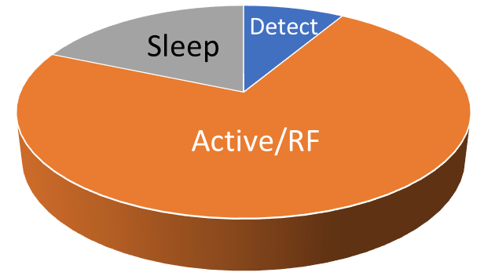
Charge Budget Example : Time
Time Budget | Mode |  |  | Units
 | Detect | Active/RF | Sleep
Duration per event | 0.2 | 5 |  | s
Events per hour | 10 | 2 |  | events / hour
Duty cycle | 0.0556 | 0.2778 | 99.6667 | %
Current (avg) | 19.7 | 168.1 | 42.9 | µA = µC/s
This product spends most energy in active mode – should consider a switched-mode regulator!
Pie charts are great for visualizing the
charge / energy budget

Slide 18
Charge Budget Example : Battery Life
Battery Budget | Value | Units
Current (avg) | 230.7 | µA
Capacity (avg) | 1000 | mAh
Target life | 180 | days
Estimate life | 180.6 | days
Margin | 0.6 | days

Slide 19
Energy / Charge Budget: Batteries
Remember to de-rate the stated battery capacity for
  Load
  Lifecycle / age
  Temperature
  Memory effects (especially NiCd and NiMH)
Account for your battery chemistry and discharge curve
  Different battery chemistries behave differently

Slide 20

Initial Design Checklist (Guideline)
Created energy budget
Confirmed that design meets energy budget
Verified power consumed by all active components
Verified power consumed by all pull-up and pull-down resistors
Inspected all signals for contention & back-powering while in low power modes
Verified that device can wake from all low power modes
Verified that microcontroller functions as needed in low-power modes
Inspected example code for low-power support with desired framework / RTOS
Use off-the-shelf development boards to prototype low-power mode operation as early as possible in the design cycle

Slide 21
Agenda
Electrical quantities
Design
Measurement
Optimization
Conclusion

Slide 22
Measurement
V
Voltage (Voltmeter)
  Op-amps
Current (Ammeter)
  Magnetic field - Galvanometer
  Voltage across resistor – Shunt Ammeter
  Active circuits - transimpedance amplifier, …
Power & Energy
  Sample voltage & current, multiply together digitally
  Numerically integrate to compute energy
A
Akin's laws of spacecraft design: [link]
Engineering is done with numbers. Analysis without numbers is only an opinion.

Slide 23
Measurement Concerns
Dynamic range (difference between the minimum value and the maximum value), particularly for current
Bandwidth and sampling frequency
Voltage drop – also called burden voltage, insertion loss
Ease of use and ease of capturing your signals of interest
Accuracy – Closeness to the actual value
Precision – Closeness to other measurements at the same value

Slide 24
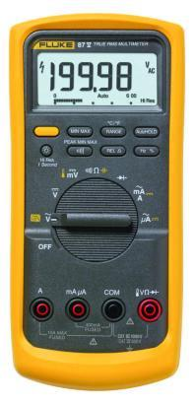
Measurement Options: Multimeter
Good for static analysis only
Procedure
  Place target device into a mode
  Make measurement without browning out device
  Repeat
Tedious and time consuming = expensive!
Fluke 87V
Source: Fluke
Many multimeters have a burden voltage > 0.6 V when measuring current!

Slide 25
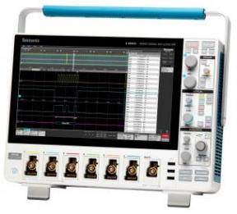

Measurement Options: Oscilloscope
Good for measuring dynamic changes over time
Procedure
  Select shunt resistor value & wattage
  Insert shunt resistor between supply + and device power input +
  CAREFULLY connect shunt to oscilloscope input – oscilloscopes are normally earth ground referenced for safety, so need
    Use two probes with mathematical subtract feature (+++offset error)
    Differential probe
    Current probe, often a differential probe with built-in shunt resistor(s)
    Electrically isolate: either float the scope or float both source & target
  Capture & convert between volts & amps using Ohm’s Law
BUT limited dynamic range: most scopes are between 8 and 12 bits
4 Series MSO
Source: Tektronix

Slide 26
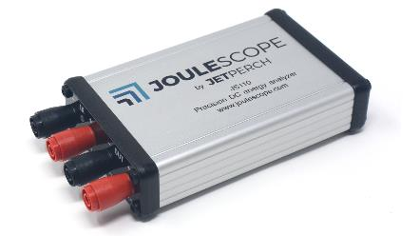
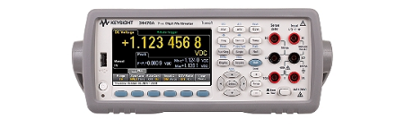

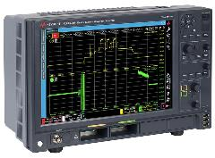
Measurement Options: Specialized Equipment
Specialized devices
  Joulescope
7-digit bench multimeter with waveform analysis
  Keysight 34470A
  Tektronix DMM7510
SMUs (Source Measurement Units)
  Keithley 2281S
  Keysight B2901A
  R&S NGL 200 power supply series
High-end, dedicated equipment
  Keysight N6705C
  Keysight CX3300 family
Source: Jetperch LLC
Source: Keysight
Source: Keysight
Source: Keysight

Slide 27

Capacitance & Bandwidth
Your target device’s capacitance reduces measurement bandwidth!
Cable resistance & inductance increases the effective source resistance
1 µF load capacitance
10 µF load capacitance
Source Resistance | Effective Bandwidth
0.01 | 16 MHz
0.1 | 1.6 MHz
1 | 160 kHz
10 | 16 kHz
100 | 1.6 kHz
1000 | 160 Hz
Source Resistance | Effective Bandwidth
0.01 | 1.6 MHz
0.1 | 160 kHz
1 | 16 kHz
10 | 1.6 kHz
100 | 160 Hz
1000 | 16 Hz
$$BW= \frac{1}{2πRC}$$

Slide 28
General Recommendations
Keep cables short to minimize noise pickup and reduce impedance
Understand voltage drop / burden voltage, bandwidth, and your measurement requirements
Avoid ground loops in test setup
  Ensure test setup has a single earth ground path or is fully isolated
  Think about grounding when adding debugging probes and UART/USB adapters - can introduce ground loops and noise!
Measure early an often – the cost of fixing an error increases with time between introduction and discovery
Don’t short out the power supply while probing your target board … again …

Slide 29
Agenda
Electrical quantities
Design
Measurement
Optimization
Conclusion

Slide 30
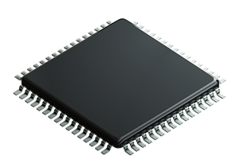
Optimization: Microcontroller
Peripherals
  Only enable those needed
  Use peripheral clock dividers if feasible
Run mode: idle/sleep/deep-sleep
  Halt processor when not needed (wait-for-interrupt)
  Enter lowest possible power state
  Remember to disable idle peripherals during sleep modes
  Consider microprocessor wake time in energy consumption calculations
Clock
  Select system clock frequency for lowest power
  Beware of flash wait states
  Consider switching to lowest power oscillator when in deepest sleep
For microprocessor / Linux systems, consider off-loading features & peripherals that operate in low power modes to a microcontroller

Slide 31
Optimization: Software
struct embc_buffer_s * embc_framer_construct_frame(
struct embc_framer_s *self,
uint8_t frame_id, uint8_t port, uint8_t message_id, uint16_t port_def,
uint8_t const *payload, uint8_t length) {
EMBC_DBC_NOT_NULL(self);
EMBC_DBC_RANGE_INT(port, 0, (EMBC_FRAMER_PORTS - 1));
uint32_t frame_crc = 0;
EMBC_LOGD3("embc_framer_construct_frame");
struct embc_buffer_s * b = embc_buffer_alloc(self->buffer_allocator, length + HEADER_SIZE + FOOTER_SIZE);
struct embc_framer_header_s * hdr = buffer_hdr(b);
hdr->sof = SOF;
hdr->frame_id = frame_id & EMBC_FRAMER_ID_MASK;
hdr->port = port;
hdr->message_id = message_id;
hdr->length = length;
hdr->port_def0 = (uint8_t) (port_def & 0xff);
hdr->port_def1 = (uint8_t) ((port_def >> 8) & 0xff);
hdr->crc8 = embc_crc_ccitt_8(0, b->data, HEADER_SIZE - 1);
b->cursor = HEADER_SIZE;
b->length = HEADER_SIZE;
embc_buffer_write(b, payload, length);
frame_crc = embc_crc32(frame_crc, b->data, b->length);
embc_buffer_write_u32_le(b, frame_crc);
embc_buffer_write_u8(b, SOF);
return b;
}
struct embc_buffer_s * embc_framer_construct_ack(
struct embc_framer_s *self,
uint8_t frame_id, uint8_t port, uint8_t message_id, uint16_t ack_mask,
uint8_t status) {
EMBC_DBC_NOT_NULL(self);
uint32_t frame_crc = 0;
EMBC_LOGD3("embc_framer_construct_ack");
struct embc_buffer_s * b = embc_buffer_alloc(self->buffer_allocator, 1 + HEADER_SIZE + FOOTER_SIZE);
struct embc_framer_header_s * hdr = buffer_hdr(b);
hdr->sof = SOF;
hdr->frame_id = EMBC_FRAMER_TYPE_ACK | (frame_id & EMBC_FRAMER_ID_MASK);
hdr->port = port;
hdr->message_id = message_id;
hdr->length = 1;
hdr->port_def0 = (uint8_t) (ack_mask & 0xff);
hdr->port_def1 = (uint8_t) ((ack_mask >> 8) & 0xff);
hdr->crc8 = embc_crc_ccitt_8(0, b->data, HEADER_SIZE - 1);
b->cursor = HEADER_SIZE;
b->length = HEADER_SIZE;
embc_buffer_write_u8(b, status);
frame_crc = embc_crc32(frame_crc, b->data, b->length);
embc_buffer_write_u32_le(b, frame_crc);
embc_buffer_write_u8(b, SOF);
return b;
}
void embc_framer_send(
struct embc_framer_s * self,
uint8_t port, uint8_t message_id, uint16_t port_def,
struct embc_buffer_s * buffer) {
EMBC_DBC_NOT_NULL(self);
EMBC_DBC_RANGE_INT(port, 0, EMBC_FRAMER_PORTS - 1);
EMBC_DBC_NOT_NULL(buffer);
uint32_t frame_crc = 0;
embc_size_t length = embc_buffer_length(buffer);
if (buffer->reserve < EMBC_FRAMER_FOOTER_SIZE) {
EMBC_LOGD("embc_framer_send buffer copy %p", (void *) buffer);
EMBC_ASSERT(length < EMBC_FRAMER_PAYLOAD_MAX_SIZE);
struct embc_buffer_s * b = embc_framer_alloc(self);
embc_buffer_write(b, buffer->data, length);
embc_buffer_free(buffer);
buffer = b;
length = embc_buffer_length(buffer);
}
EMBC_ASSERT(buffer->reserve == EMBC_FRAMER_FOOTER_SIZE);
buffer->reserve = 0;
struct embc_framer_header_s * hdr = buffer_hdr(buffer);
hdr->sof = SOF;
hdr->frame_id = self->tx_next_frame_id;
hdr->port = port;
hdr->message_id = message_id;
hdr->length = (uint8_t) ((length - HEADER_SIZE) & 0xff);
hdr->port_def0 = (uint8_t) (port_def & 0xff);
hdr->port_def1 = (uint8_t) ((port_def >> 8) & 0xff);
hdr->crc8 = embc_crc_ccitt_8(0, buffer->data, HEADER_SIZE - 1);
frame_crc = embc_crc32(frame_crc, buffer->data, length);
embc_buffer_cursor_set(buffer, length);
embc_buffer_write_u32_le(buffer, frame_crc);
embc_buffer_write_u8(buffer, SOF);
self->tx_next_frame_id = frame_id_incr(self->tx_next_frame_id);
embc_list_add_tail(&self->tx_queue, &buffer->item);
transmit_queued(self);
}
void embc_framer_send_payload(
struct embc_framer_s * self,
uint8_t port, uint8_t message_id, uint16_t port_def,
uint8_t const * data, uint8_t length) {
EMBC_DBC_RANGE_INT(length, 0, EMBC_FRAMER_PAYLOAD_MAX_SIZE);
EMBC_LOGD3("embc_framer_send_payload");
struct embc_buffer_s * b = embc_framer_alloc(self);
embc_buffer_write(b, data, length);
embc_framer_send(self, port, message_id, port_def, b);
}
void embc_framer_resync(struct embc_framer_s * self) {
EMBC_DBC_NOT_NULL(self);
rx_purge_queued(self);
tx_purge_queued(self);
embc_framer_send_payload(self, 0, 0, EMBC_FRAMER_PORT0_RESYNC, 0, 0);
}
Profile! Most code doesn’t matter for energy consumption
Reduce active time as much as possible
  Smaller, tighter, faster code consumes less power
  Don’t spin-wait for long, use a timer or other ISR when wait time exceeds mode switch time (active → sleep → active)
Consider running performance-critical code segments from core‑coupled RAM when flash has wait states
Minimize core interrupts when possible
  Use DMA for data flow during sleep modes
  Take advantage of dedicated hardware - known under different brand names, such as Atmel® SleepWalking

Slide 32
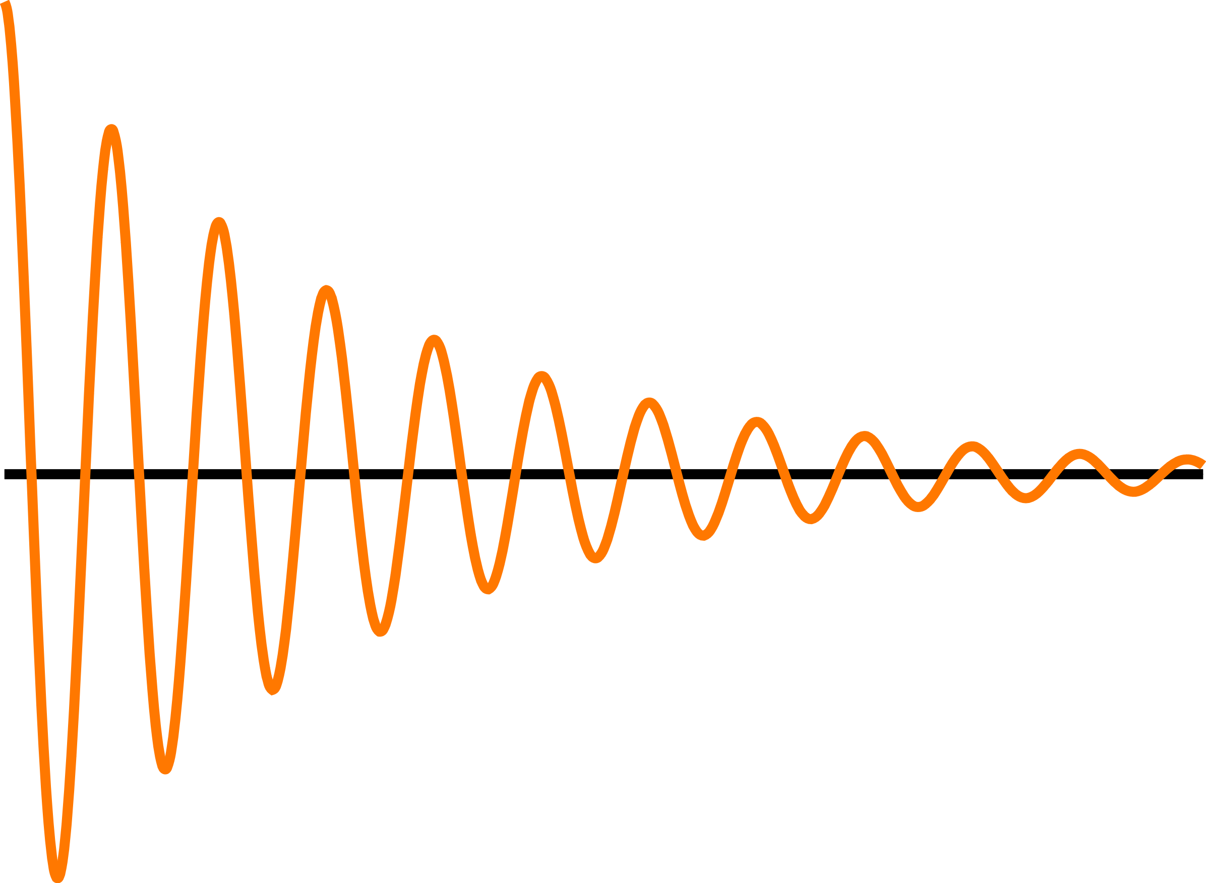
Optimization: Signals & GPIO
Consider each pull-up / pull-down resistor
  These resistors consume power, and a single pull-up/pull-down can exceed the entire sleep budget
  Ensure that the lowest power signal mode matches the pull direction
  Give special consideration to reset signals and boot mode selection pins, especially when reused for other purposes in the design
Set GPIO configuration in sleep mode
  Lowest power mode (often output to 0)
  Ensure no conflicts
Be especially careful with regulator enable signals

Slide 33
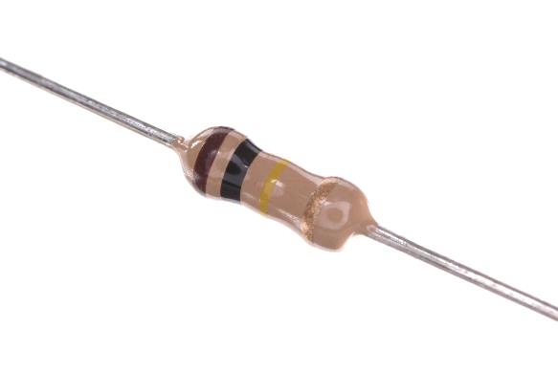
Optimization: Components
Source: Flickr, bomazi
Consider both active and sleep currents when selecting components!
Prefer low quiescent current (low sleep/inactive currents)
OR use a P-channel MOSFET to disable other components, BUT
  Ensure that the design does not backpower through signals – most ICs contain a diode between each pin and VCC
  Ensure that you place a pull-up between the gate and drain
  Consider leakage currents
Use care with multiple power domains with individual regulator enables

Slide 34




Optimization: User Interface
Discrete buttons consume zero current (best for low power design)
Capacitive touch can be reasonably low-power, but test
Ensure that the design does not have to scan a button matrix in lowest power mode
Consider e-ink displays if a display must remain “on”
Many products naturally want to illuminate LEDs in sleep mode, but this can easily obliterate the power budget

Slide 35
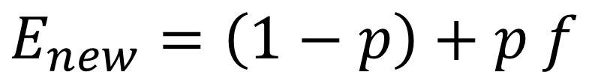
Optimization: Other
Solder flux residuals can reduce power-ground impedance
  Keep +V trace spacing as large as possible for µA level sleep currents
  Considering washing several prototypes to see if that affects sleep current
Optimize what matters
$$E_{new}=\left(1−p\right)+p f$$
Expected improvement:
p = fraction of energy consumed by contributor
f = fraction of original energy now consumed by contributor
E_{new} = total relative energy consumed after change

Slide 36
Agenda
Electrical quantities
Design
Measurement
Optimization
Conclusion

Slide 37
Conclusion
Reducing energy consumption requires effort and attention throughout the entire design process
  Multi-faceted concern that affects many decisions
  Deferring low power design increases risk and likelihood of delays
Components, test equipment and resources exist to help you be successful with reducing energy consumption in your designs
New instruments allow you to cost-effectively quantify the impact of your design changes for rapid feedback

Slide 38
Thank you!
Matt Liberty
Principal Engineer
Jetperch LLC
matt@jetperch.com
Twitter: @mliberty1

